Slide 1
Restaurant Management System
By Yi Yang, Kun Chen, Rui Da

Slide 2
Product Introduction
This product will be a generically designed restaurant management system. It can be imported to any kind of restaurant.

Slide 3
Functionalities
Make reservation
Check in
Assign waiter automatically
Make an order
Check out
Separate or combine check

Slide 4
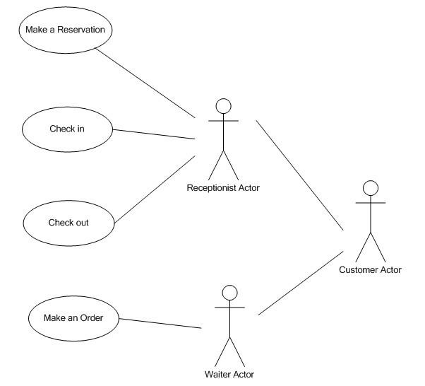
Use Case Diagram

Slide 5
Use Case: Make a Reservation
Actor: Receptionist
Goals: Help customer make a reservation for a specific date and time.
Precondition:
Summary: Receptionist finds available table for the specific date and time, record contact information, reserves the table for customer.
Related use case: None

Slide 6
Steps:
Actor actions System responses
1. Select “Reservation” command 2. Pop up reservation window
3. Select date and time, then search 4. Display all available tables the system
5. Select table size, type into 6. Pop up message indicates customer’s name and cell phone, making reservation successfully
submit reservation
7. Return to main window
Postconditions: table reserved for customer, record inserted into database, available table number decreases

Slide 7
Scenarios
Make a reservation
Steps:
Actor actions System responses
Select “Reservation” command Pop up reservation window
Set October 20 for date and Display all available tables
dinner for time, then search the
system
Type customer name “David”, Pop up message indicates making
cell phone “336-334-1234”, reservation successfully
reserve the table
Return to main window

Slide 8
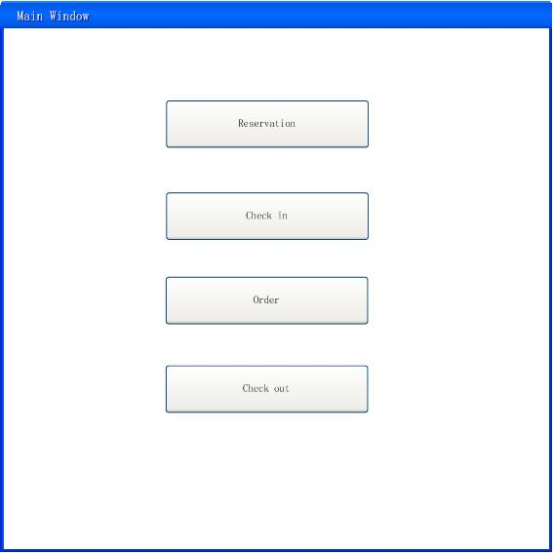
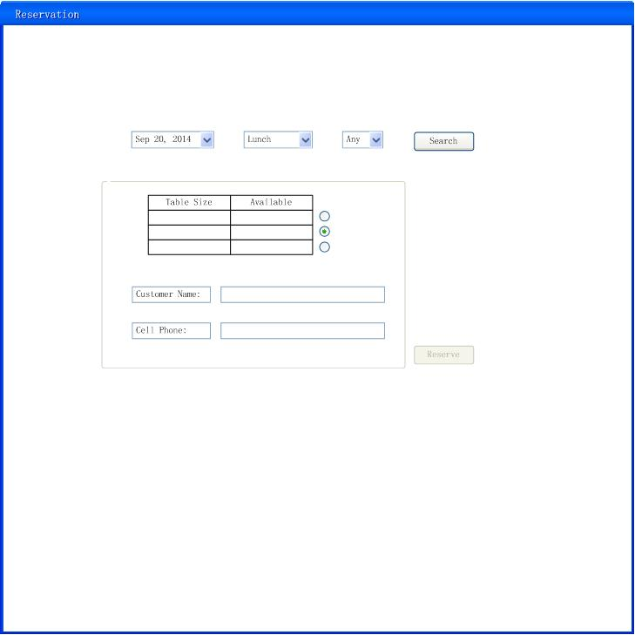
Interface

Slide 9
Use Case: Check In
Actor: Receptionist
Goals: Assign an available waiter and seat to customer.
Preconditions: The receptionist must have the basic information of the customer.
Summary: When a certain customer comes to the front desk, receptionist needs to get basic information of this customer and use this software to find out an available seat and waiter to serve.

Slide 10
Steps:

Slide 11
Scenarios 1
Actor actions System responses
1.Choose “check in” command 2. Display a new interface to prompt receptionist to type last name of customer, cell phone number and group size.
3.Input “Chen” into “user name”
text box
4. Input “123-345-3232” into “cell phone”
text box
5. Input “4” into “group size” text box
6. Click “Search”
7. Display “David” (Waiter’s name), “3”(Table number)
8.Click”OK”
9. Go back to the original interface

Slide 12
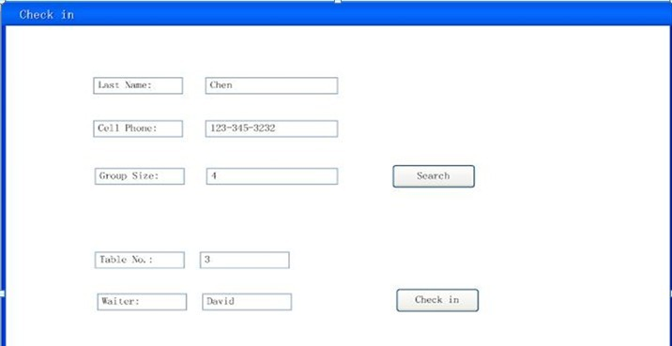
Sketch 1

Slide 13
Scenarios 2
Actor actions System responses
1.Choose “check in” command 2. Display a new interface to prompt receptionist to type last name of customer, cell phone number and group size.
3.Input “Chen” into “user name”
text box
4. Input “123-345-3231” into “cell phone”
text box
5. Input “4” into “group size” text box
6. Click “Search”
7. A message box pops out and shows that “Invalid information for reservation”
8.Click”OK”
9. Go back to the original interface

Slide 14
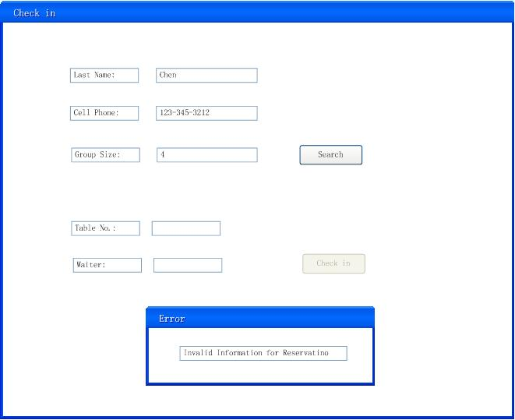
Sketch 2

Slide 15
Use Case: Make An Order
Actors: Waiter
Goals: To make an order
Preconditions: Guests must have checked in successfully
Summary: Price will prompt up and total will be computed after each guest has finished an order
Post condition: Order information should be recorded to database successfully

Slide 16
Steps:
Actor actions | System responses
1. Choose “Order” in main page. | 2. Direct to order page.
3. Type in waiter name and table number, and then click “Submit” to initialize the order page. | 4. Display several rows according to the guest number, including name, order detail and a “Edit” button.
5. Choose a guest and click “Edit” button. | 6. Direct to menu page.
7. Click “Appetizer”, “Entrée” or “Dissert” to order. | 8. Prompt a list of menu.
9. Sort the courses by hitting the sorting button. | 10. Display courses of the chosen category.
11. Choose the courses and input the amount, click “Done” when the order is completed. | 12. Direct to order page again. Order detail should be displayed after guest name. If there is any other guest waiting to order, click “Edit” button and repeat step 5-12.
13. Click “Done”. | 14. Direct to summary page. Display table number, order detail for the whole table and a “Print” button to print out the summary.
15. Click “Print”. | 16. Print out an order summary of this table.

Slide 17
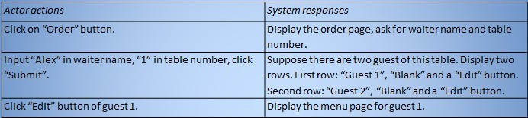
Scenarios
Steps:

Slide 18
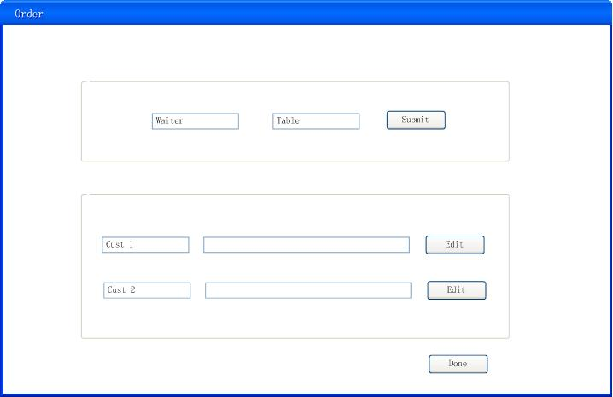
Order Page

Slide 19
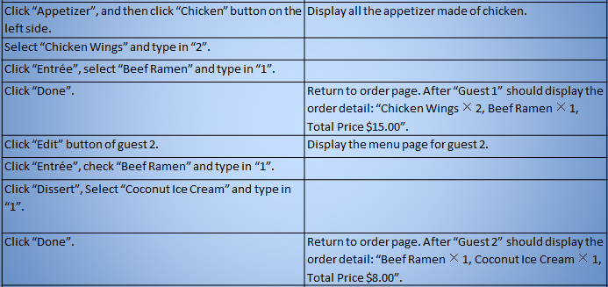

Slide 20
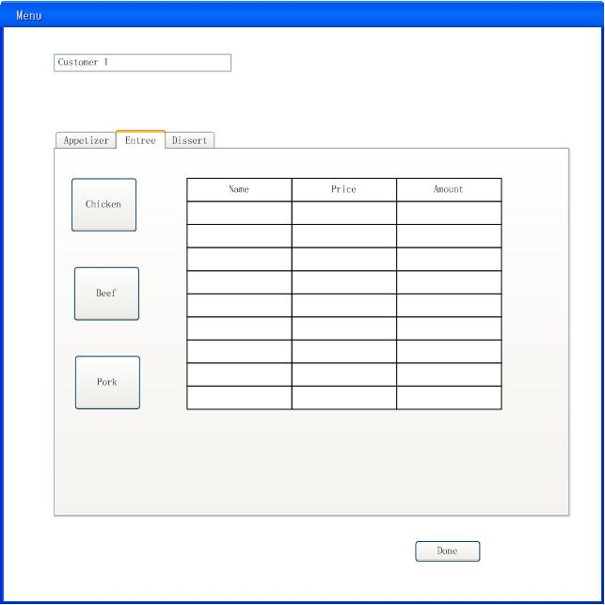
Menu Page

Slide 21
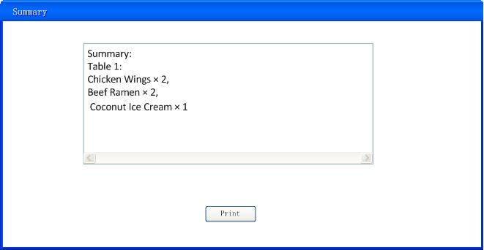
Summary Page

Slide 22
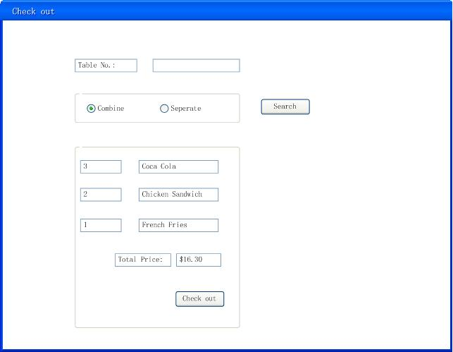
Use Case: Check Out

Slide 23
Thank you!

